Slide 1
X1000
Steps for OTA Upgrade

Slide 2
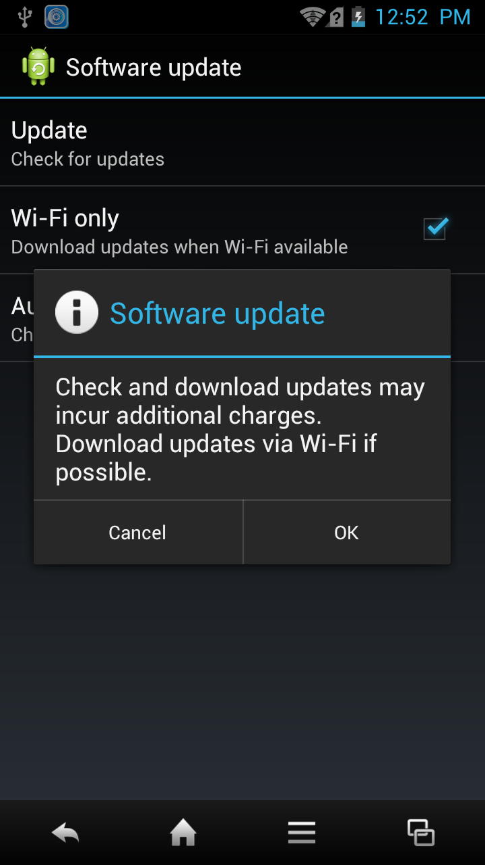
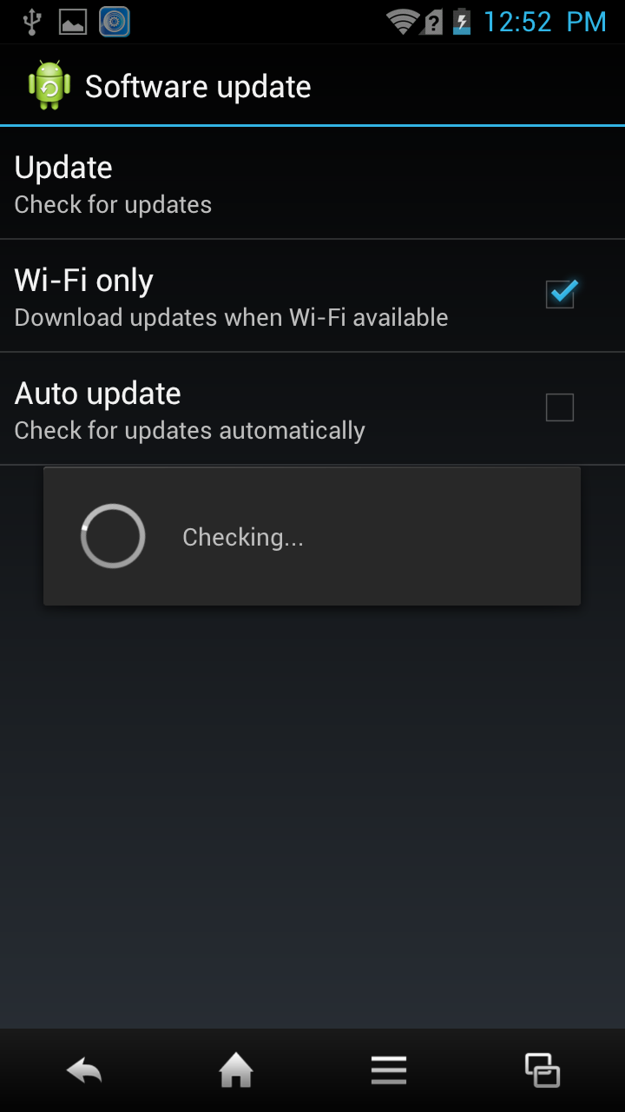
X1000
Go to Phone Settings>About Phone>
Software update. Above screen will come when you tap on Update.
Once you tap on OK, device will check for software update

Slide 3
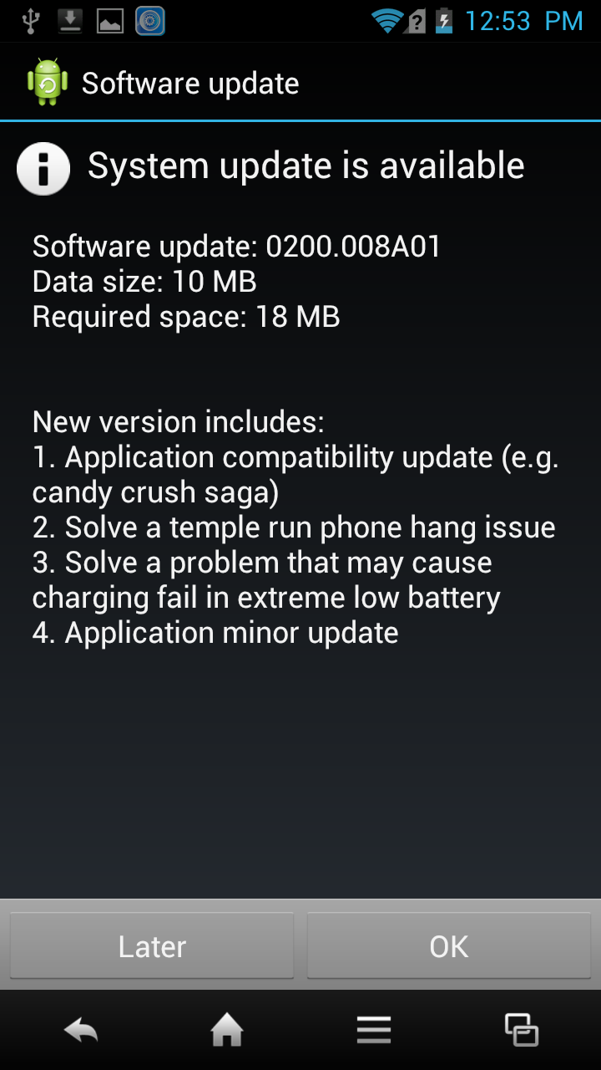
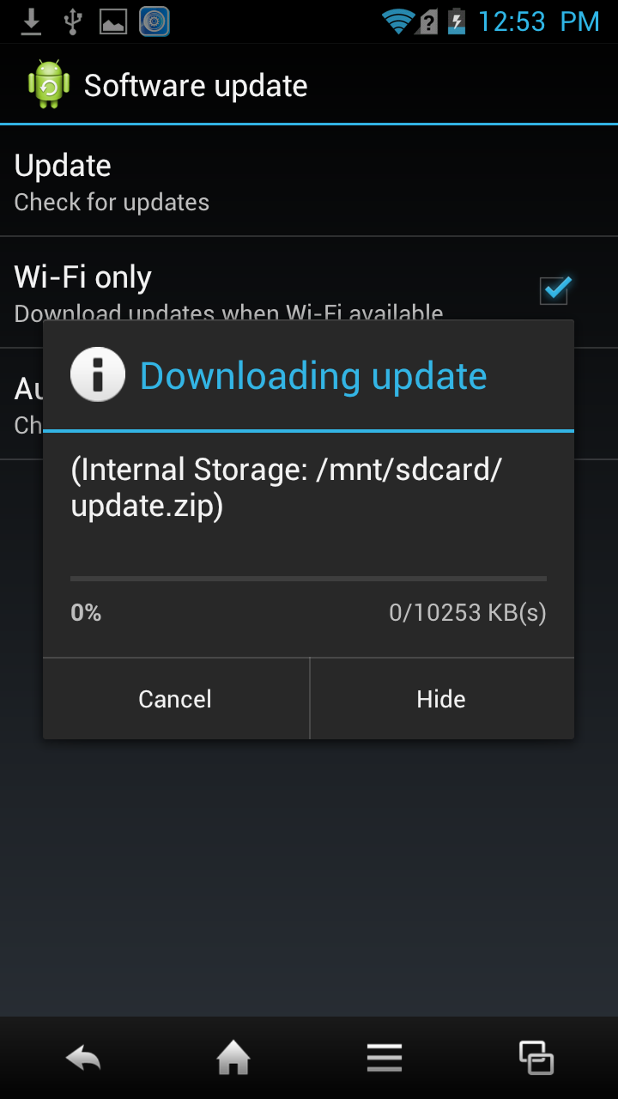
X1000
Touch on OK to download the update
You can see download progress,
0 to100%

Slide 4
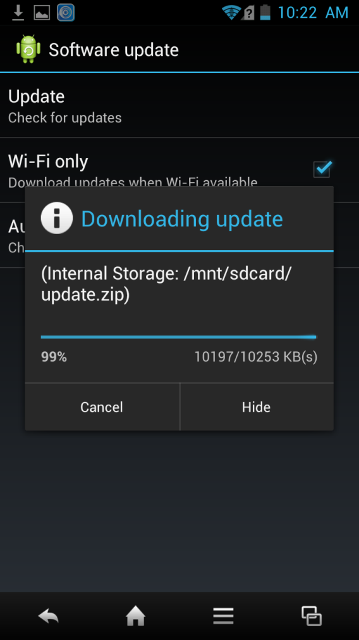
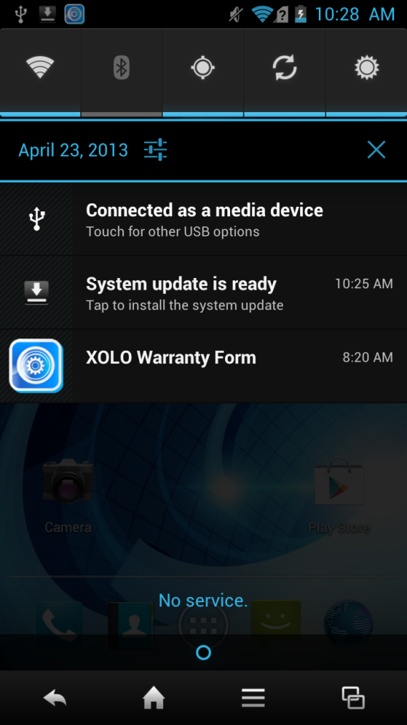
X1000
Download progress 99%
Device will show System update is ready once download is complete, Tap to install the update as mentioned in screen

Slide 5
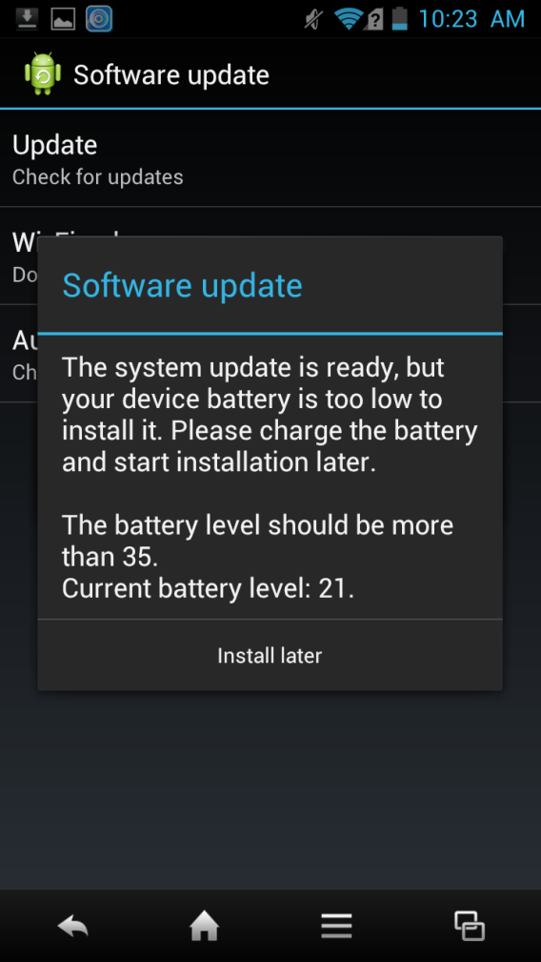
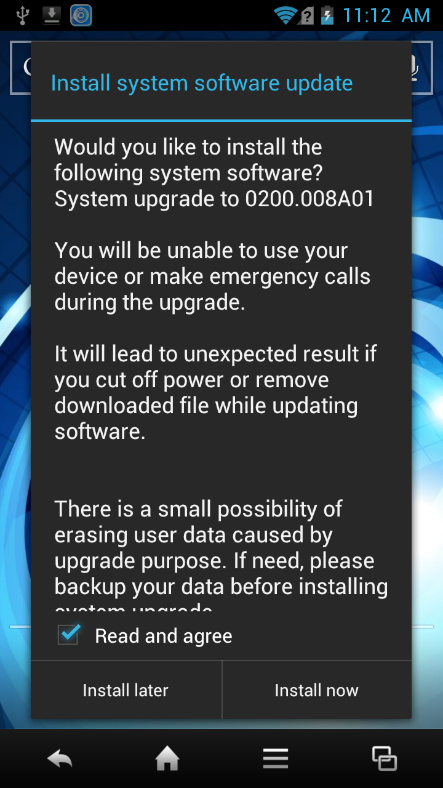
X1000
Device will show above pop up if battery level is less than 35%, we recommend that battery level should be min. 70% for smooth software upgrade
Tap on Install Now to install the update.
After this device will reboot

Slide 6
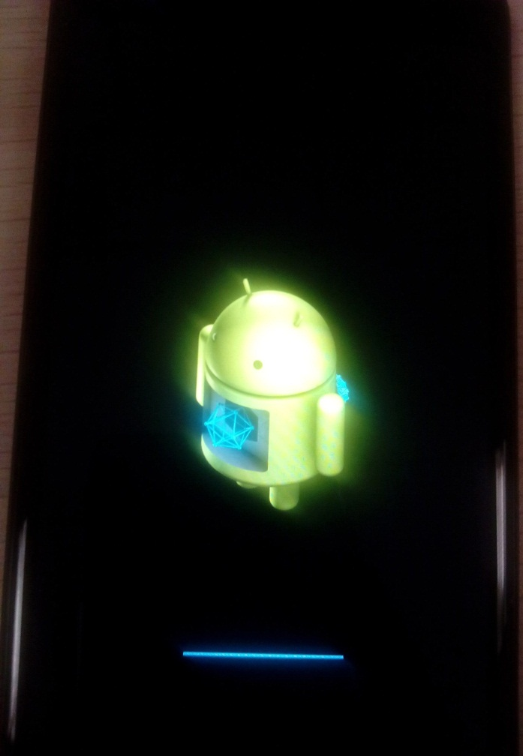
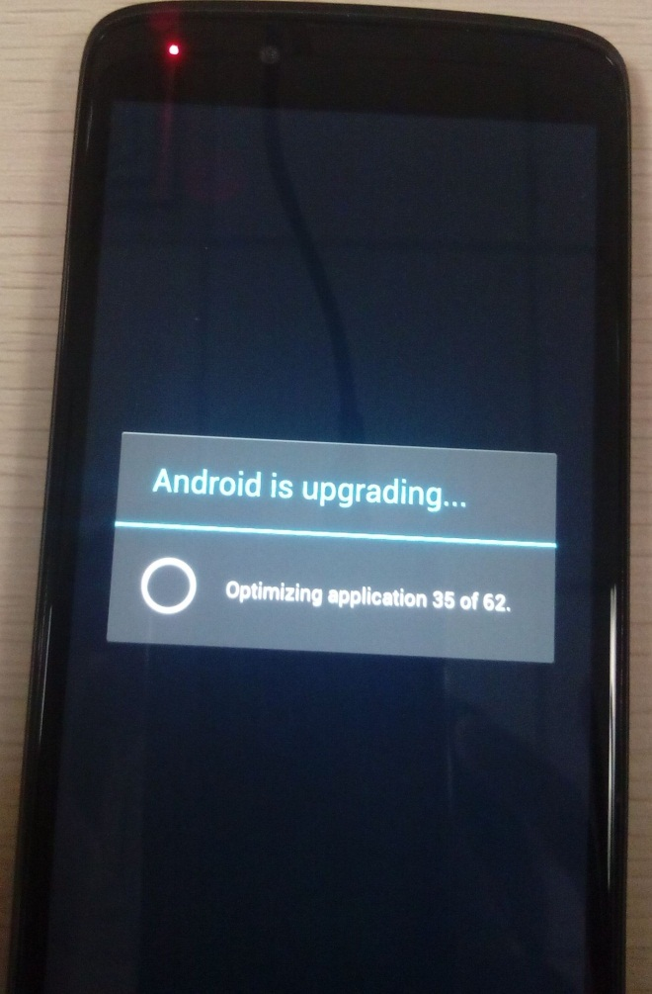
X1000
After reboot device will go under Droid mode
for upgrading the software as shown above
After Droid mode device will upgrade
the Android as shown above

Slide 7
Thank You

